Slide 1
Unpacking the Public Sector Challenge

Slide 2
Objectives
The objective of this guide is for the joint Public Sector – Startup team to gain a thorough understanding of the Public Sector challenge, its context and institutional embeddment.
Desired outcome
Startup teams will gain a clearer and more in detail understanding of the problem and challenge at hand.
The Startup- Public Sector team has a joint understanding of the nature, context and boundaries of the Public Sector problem.
Any riskiest assumptions and questions are identified and the basis for the collaboration process to solve the challenge are laid.

Slide 3
Content
Public Sector Organisation Preparations
Activities:
Assumptions and Questions
Many Hats
De-Brief

Slide 4
Public Sector Organisation Preparations
Notes:
You can use these slides to present to the public sector organisation to help them prep for the session.

Slide 5
Task for the Public Sector organisation: Frame the problem to help others better understand the challenge space
The following slides contain a guide for what information the Public Sector organisation should be presenting and communicating at the session.
The format they should prepare in will mainly be as a presentation, but suggestions for other media and even people to bring should be considered.
They need to make sure they prepare this before the session and are ready to help everyone better understand the problem space and unpack it.
The information provided should be based on the Innovation Need Assessment (Public Challenge Canvas) from Module 1, Session 1

Slide 6
PUBLIC SECTOR CHALLENGE CANVAS

Slide 7
Achieving a common understanding
As first joint meeting of the Startup- Public Sector team, it is of tremendous importance to achieve a joint and thorough understanding of the Public Sector Challenge.
Remember that the knowledge of the Startup so far is limited and the Startup team most likely won’t have any information on your motivations, internal discussions or lessons-learned so far in similar processes.
Try to provide the Startup with an extensive overview over the different facetts of the Challenge you want to solve.
Try to also provide information that reflect on your internal procecess, past attempts to solve the challenge and lessons learned you gathered along the way. Openess and transparency will lay a good foundation for cooperation.
Answering the suggested questions in the canvases on the next slides will also help you to have a internal discussion in the Public Sector and achieve a joint understanding.

Slide 8
Suggested Materials, formats and people to bring
Presentation
Audio, Video, Images
People
Documents
Prepare a presentation that will provide the required information ahead of the session.
The Canvases on the next slide provide an orientation on the necessary information and can be used to present the Challenge, but so can any material that you have compiled already.
Bring things to life:
Provide images of people, things and places to give context
Any audio or video recordings of users, staff or the service experience will make your presentation more relatable and interesting.
Bring actual users and people that are impacted by the problem.
These bring things to life, make it real, and hearing directly from those impacted is very powerful.
Additionally any experts that can provide key knowledge can also help.
Bring any useful and relevant documents and materials that would be helpful for people to see or have.
Gather them in a folder, on a USB stick or bring print outs, so Startup Teams have all relevant information to kick-start the project.

Slide 9
The Public Sector Challenge
What is the Problem?
Who are the users?
What does it impact?
When?
What is the problem that you have identified and need to be solved?
Is it a real/validated problem supported by research (data and experience)?
Who has this problem? Who are the users/residents that experience it?
How many? Demographics? Groups?
What are their needs, challenges and frustrations?
What staff or people in the org does it impact and how?
Are there processes that it impacts?
What about other teams, people etc?
When does the problem happen?
Are there other things happening? (before, during and after?)
What triggers it and when?
How?
Why?
Gaps?
How does this problem occur?
How does it impact users experiences?
Where?
Why is the problem important?
Why do you need to solve it?
What is the impact on users and on the business?
Do we know some potential root causes?
Are you aware of any gaps in your understanding that need to be found out?
Any missing information at this point?
Anything that would be good to know more about?
Where does this problem happen?

Slide 10
The Public Sector Challenge
Processes
Data
Technology
Existing Solutions or ideas
What kind of processes are involved? Digital, people, physical etc.
How does the service work currently?
Any documents or demos that could help understanding of these?
What data do you have related to the problem?
What data can you start collecting today as evidence for the problem?
Any technology and systems used currently?
What solutions or ideas have been tried or tested already in the past?
Barriers and Challenges
Are there any potential barriers or challenges people need to be aware of?
Think of internal (procurement, integration with existing systems, ...) and external (competitors, markets, ...) barriers.
Outcomes & Expectations
Anything else?
What kind of outcome do you expect to happen if the problem is solved?
What changes would need to happen?
What else could be helpful to give context and a deeper understanding?

Slide 11
Unpacking the Public Sector Challenge

Slide 12
Agenda
Time: 3 Hours
5 mins | Introduction and objectives for the day
30 mins | Public sector organisation presentation
30 mins | Activity part 1
15 mins | Break
30 mins 45 mins | Activity part 2 Debrief

Slide 13
Public Sector Challenge Presentation (add slides or materials)

Slide 14
Suggested Activities
Please select one or several activities

Slide 15
Assumptions and Questions
ACTIVITY

Slide 16
Assumptions and Questions
1 - 1.5 hours
In person or online
To help the team understand what part of the Public Sector Challenge they know and what they still need to find out.
Reduce risk in the project by stating assumptions, identifying the riskiest ones and how might they be mitigated.
Start-ups teams to do this activity after listening to the Public Sector’s challenge presentation.
Ensure to present the activity before the Public Sector Challenge Presentation
Startups,
Public Sector Core Team but If other representatives from the Public Sector are present, they can likewise participate,
Additional Public Sector colleagues
Post-its
Paper

Slide 17
Assumptions and Questions
1
Identify assumptions and questions (20 minutes)
As individuals, write one assumption or question per post-it. Write as many as you can think of.
What do we mean by assumption in this context?
Since Startups might be new to the problem and the organisations, there might me some facts that only rely on suppositions they have as new actors in this field.
We will consider those as assumptions, meaning, statements that are believed to be truth by someone and that are key to the issue that needs to be solved.
If they do not have assumptions, they might have doubts about the problem. We will call these questions.
Notes:
Instructions for facilitator:

Slide 18
Assumptions and Questions
Examples of assumptions
“The data presented by the government seems not to consider people from 18-34 years old”
“That kind of user likes to use digital solutions”
“Men and women older than 60 prefer to reach the service using remote channels”
“The municipality has no capabilities nor capacity to deal with this problem”
“The solutions that are available in the market are much cheaper but very low quality”
Notes:
Instructions for facilitator:

Slide 19
Assumptions and Questions
2
Teams share assumptions and questions
5 mins per team: Facilitators ask the Startup team(s) to share their assumptions and questions about the problem.
As people share, add each teams post-its onto the list of assumptions organised by assumption and questions. Group together similar ones.
Get people to think about:
What they heard in the presentation
What questions they still have
What assumptions they have about the problem
Assumptions
Questions
Notes:
Instructions for facilitator:

Slide 20
Assumptions and Questions
High risk
3
Map assumptions and questions to assess risk
15 mins
Draw a 2 x 2 grid like the one picture on the right. You can also prepare this in a digital format if preferred.
Teams will need to evaluate each post-it and plot them onto the grid where they think is makes the most sense
Risk: degree in which this question or assumption can have a high or low risk for the project if they are not clarified.
Certainty: degree in which the response to this question or assumption is known or not known by the team.
We recommend having a 15-20 min break after this activity
Certain
Un-certain
Low risk
Notes:
Instructions for facilitator:

Slide 21
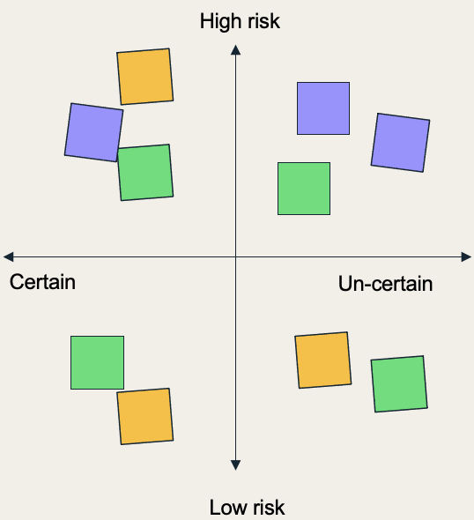
Assumptions and Questions
Assumptions and questions
How might we validate or invalidate it?
4
Take the high risk and uncertain items and stack into a list
15 mins
The quadrant is prioritised since it’s critical to better understand first what we don’t know much about, and since we don’t know, can have a higher impact on the project.
Each team should go through each item and think about different way to validate or invalidate each.
For example, do you need to talk to someone? Is someone in the room able to clarify this? Do you need to test something with staff or users? Do you need to do more research?
Notes:
Instructions for facilitator:

Slide 22
Assumptions and Questions
5
Teams share their list of riskiest assumptions and questions.
5 mins per team
6
What happens to the riskiest assumptions?
Keep these riskiest assumptions in a live document (e.g. GoogleDoc, WordDoc).
We could use them later for:
Follow up questions for the public sector organisation team.
Use them for planing user research (that will be introduced in module 3).
Notes:
Instructions for facilitator:

Slide 23
Many Hats
ACTIVITY

Slide 24
Many Hats
20 minutes
In person or online
Getting participants to ask questions and probe about the problem so they can gain a deeper and better understanding about the problem at hand.
It gives people “hats” (roles) to look at a problem from different perspectives and prompts them to ask questions from those perspectives.
Start-ups teams to do this activity after listening to the Public Sector’s challenge presentation.
Ensure to present the activity before the Public Sector Challenge Presentation
Startups,
Public Sector Core Team (if other representatives from the Public Sector are present, they can likewise participate),
Additional Public Sector colleagues
“Hat roles” digitally ready to send to participants or printed to give out in person.
Post-its or a document to take notes and capture questions

Slide 25
Instructions
1
Customise and amend the ‘hat roles’ in the template
The template provides some suggestions on types of ‘hats’ to use. Amend and add the roles as necessary and that are relevant for the problem space.
4
After the presentation, get people to ask their questions and capture anything that needs to be an action
You should help capture things that need more research, followup or has an action. Collect post-its to collate as questions that still need to be answered.
This can then be shared with everyone, and can also be a list for the start-ups or the public sector organisation team to follow-up on.
2
Give out the different “hats” before the presentation by the public sector organisation, either:
Randomly assign individuals a hat
Or 1 hat per team - make there are enough hats with the number of teams.
3
During the presentation, get people to write questions on post-its
They should be thinking from the perspective of the “hat” they received.
They can still ask other questions if they have it.
Notes:
Instructions for facilitator:

Slide 26
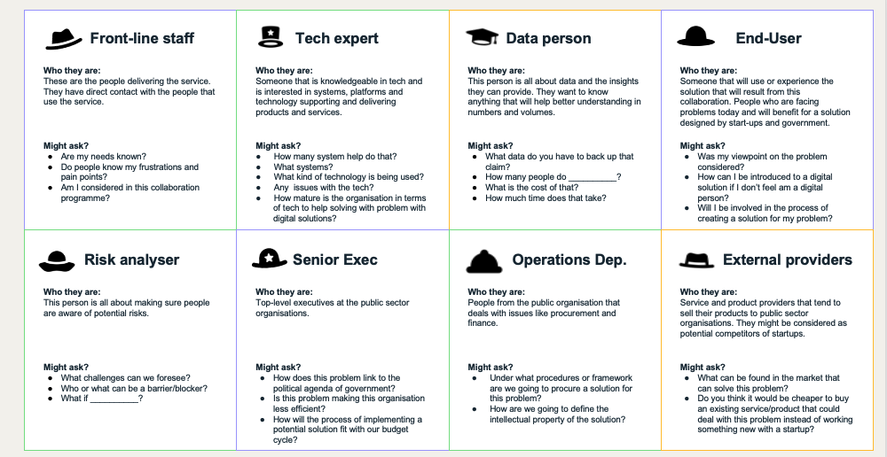
Hat Roles
Hat Roles template
The template provides some suggestions on types of ‘hats’ to use. Amend and add the roles as necessary and that are relevant for the problem space.
How to print
Print out on a A4 or A3 paper, single sided, and cut out into cards.
Use it on the computer
Show this on a screen or send to the participants. Assign or get people to pick a role.

Slide 27
Front-line staff
Tech expert
Data person
End-User
Who they are:
These are the people delivering the service. They have direct contact with the people that use the service.
Who they are:
Someone that is knowledgeable in tech and is interested in systems, platforms and technology supporting and delivering products and services.
Who they are:
This person is all about data and the insights they can provide. They want to know anything that will help better understanding in numbers and volumes.
Who they are:
Someone that will use or experience the solution that will result from this collaboration. People who are facing problems today and will benefit for a solution designed by start-ups and government.
Might ask?
Are my needs known?
Do people know my frustrations and pain points?
Am I considered in this collaboration programme?
Might ask?
How many system help do that?
What systems?
What kind of technology is being used?
Any issues with the tech?
How mature is the organisation in terms of tech to help solving with problem with digital solutions?
Might ask?
What data do you have to back up that claim?
How many people do __________?
What is the cost of that?
How much time does that take?
Might ask?
Was my viewpoint on the problem considered?
How can I be introduced to a digital solution if I don’t feel am a digital person?
Will I be involved in the process of creating a solution for my problem?
Risk analyser
Senior Exec
Operations Dep.
External providers
Who they are:
This person is all about making sure people are aware of potential risks.
Who they are:
Top-level executives at the public sector organisations.
Who they are:
People from the public organisation that deals with issues like procurement and finance.
Who they are:
Service and product providers that tend to sell their products to public sector organisations. They might be considered as potential competitors of startups.
Might ask?
What challenges can we foresee?
Who or what can be a barrier/blocker?
What if __________?
Might ask?
How does this problem link to the political agenda of government?
Is this problem making this organisation less efficient?
How will the process of implementing a potential solution fit with our budget cycle?
Might ask?
Under what procedures or framework are we going to procure a solution for this problem?
How are we going to define the intellectual property of the solution?
Might ask?
What can be found in the market that can solve this problem?
Do you think it would be cheaper to buy an existing service/product that could deal with this problem instead of working something new with a startup?

Slide 28
Empty hats
Use these empty templates if you can think of any other actor that might be relevant to include.
Give them a name or title, describe who they are and what they might ask.
?
?
?
Who they are:
Who they are:
Who they are:
Might ask?
Might ask?
Might ask?
?
?
?
?
Who they are:
Who they are:
Who they are:
Who they are:
Might ask?
Might ask?
Might ask?
Might ask?

Slide 29
De-Brief
ACTIVITY

Slide 30
Instructions
At the end of the session it is important to document the outcomes with regards to the Public Sector Challenge as common understanding for the joint Startup-Public Sector team.
This common understanding will support the team of having a joint goal for the collaboration phase.
The common understanding will be included in the Collaborative Innovation Canvas Artefact in Module 4, Session 3.
Make sure to fill in the following slide based on an understanding that both sides share and can agree upon.
2
Next to the joint understanding of the Public Sector Challenge, there will certainly be points that are still unclear or uncertain.
These assumptions and uncertainties have to be documented likewise, as these will be included in the Assumption and Adaptation Backlog Key Tool in Session 3 of this module.
Fill in the assumptions and open questions based on your previous discussion on the slide. After the next Module, presenting the Startup solution, possible adaptation agreements will be included.
1
Notes:
Instructions for facilitator:

Slide 31
Common Understanding of the Public Sector Challenge
Based on the Public Sector Challenge presentation and the following discussion throughout the Activities “Riskiest Assumption“ and/or “Many Hats“ participants have gained a thorough understanding of the Public Sector Challenge
Please use the following template to formulate a joint understanding of the Public Sector Challenge, its scope and the target group that is affected by the challenge.
Please feel free to add additional information or sections to personalize your Common Understanding template.
Use the material presented by the Public Sector Organisation, as well as your discussions during the session as basis. If there is no agreement on certain aspects or specificities, include the points as assumptions in the second canvas.

Slide 32
Common Understanding of the Public Sector Challenge
What’s the Challenge that you are trying to solve together? What is the scope and deliminations?
What aspects of the broader context will not be part of the Public Sector Challenge you want to solve together?
What target group is affected by the challenge (end-user, intermediary, society, …)
Other important aspects, that you would like to document, based on your discussion?

Slide 33
Adaptation and Assumption Backlog
Based on the Public Sector Challenge presentation and the following discussion throughout the Activities “Riskiest Assumption“ and/or “Many Hats“ participants have gained a thorough understanding of the Public Sector Challenge.
Please record everything that is not yet clear or uncertain, in order to include it at the later stage in the Adapation and Assumption backlog.
Elements that might be unclear or based on assumptions could be in the following categories:
Knowledge of the user (end-user, intermediary, society, etc.)
Value proposition
Involvement of stakeholders (internal/external)
Deleminations of the problem

Slide 34
Common Understanding of the Public Sector Challenge
Riskiest Assumptions
Open Questions
Steps in the Collaboration Process to address these
Steps in the Collaboration Process to address these

