Slide 1
Getting to know the Startup Solutions

Slide 2
Objectives
The objective of this guide is to provide the Public Sector Organisation with a better understanding about the Startup Solutions and identify uncertainties or adaptation proposals on the solution side early on in the collaboration process.
Desired outcome
The Public Sector Organisation will have a good understanding about the Startup solutions and the team agrees on the necessary modifications or support needs of the Startup team to make the solution operational in the Public Sector context.

Slide 3
Objectives
The objective of this guide is to provide the Public Sector Organisation with a better understanding about the Startup Solutions and identify uncertainties or adaptation proposals on the solution side early on in the collaboration process.
Desired outcome
The Public Sector Organisation will have a good understanding about the Startup solutions and the team agrees on the necessary modifications or support needs of the Startup team to make the solution operational in the Public Sector context.

Slide 4
Content
Preparing and planning the session
Suggested agenda
Startups preparations for the session
Suggested activities:
Assumptions & Questions
Many Hats
De-Brief
To jump right to the respective points you’ll have to be in presentation mode

Slide 5
Preparation for Startups

Slide 6
Task for each Startup:
Gather and prepare information and materials about your solution to present at the session!
The following slides contain a guide for what information each Startup should be presenting and communicating at the session.
They can use slides or any other type of documents they prefer.
They need to make sure they prepare this before the session and are ready to help the Public Sector organisation understand the solution they have to offer.

Slide 7
What kind of information should you prepare?
It depends if you have an existing solution already or not –but some information will be similar
You have a solution / product that already that exists
You have a solution but it doesn’t fully exist yet

Slide 8
If you have an existing solution/product, tell us:
What is it?
Who is it for?
What problem does it solve?
Can you show it?
What is the proposition?
What is its use?
Who are the users? (primary and secondary)
Who will use it or interact with it?
Are there processes that it impacts?
What about other teams, people etc?
Do you have a demo to show for people to interact with?
Are there videos to show its use?
Where it‘s been used
Has there been any research done?
Barriers and challenges
Technology
Is it being used elsewhere?
Case studies to show how and for what.
What is the impact so far in these scenarios?
What are users saying?
Any barriers or challenges you have faced in applying it / implementing it in places?
What do you foresee as a potential challenge to work through?
What kind of tech is being used?
What research already exists?
Have you learned anything that is interesting and relevant?

Slide 9
You have a solution that doesn’t fully exist yet, tell us:
What is it?
Who is it for?
What problem does it solve?
Can you show it?
What is the proposition?
What is its use?
Who are the users? (primary and secondary)
Who will use it or interact with it?
Are there processes that it impacts?
What about other teams, people etc?
Do you have a demo to show for people to interact with?
Are there videos to show its use?
Has there been any research done?
Barriers and challenges
Technology
Any barriers or challenges you have faced in applying it / implementing it in places?
What do you foresee as a potential challenge to work through?
What kind of tech is being used?
What research already exists?
Have you learned anything that is interesting and relevant?

Slide 10
Suggested Materials, formats and people to bring
Presentation
Audio, Video, Images
Demo, things to show
Documents
Prepare a presentation that will provide the suggested information.
You can also use the Business model canvas and the Product canvas to help you organise, collect and show information.
Bring things to life:
Provide images of people, things and places to give context
Any audio or video recordings of users, staff or the service experience will make your presentation more relatable and interesting.
Show things to make it tangible and increase understanding
Show a demo of the solution
Diagrams and processes
Bring any useful and relevant documents/materials
that would be helpful for people to have access to.

Slide 11
Agenda
Time: 2 Hours
5 mins | Introduction and objectives for the day
50-60 mins | Activity: Sharing session
5 mins | Short break
50-60 mins | Activity: Sharing session continues
5 mins | Introduction and objectives for the day
50-60 mins | Activity: Sharing session
5 mins | Short break

Slide 12
Why tools?
because they help
communicate solutions

Slide 13
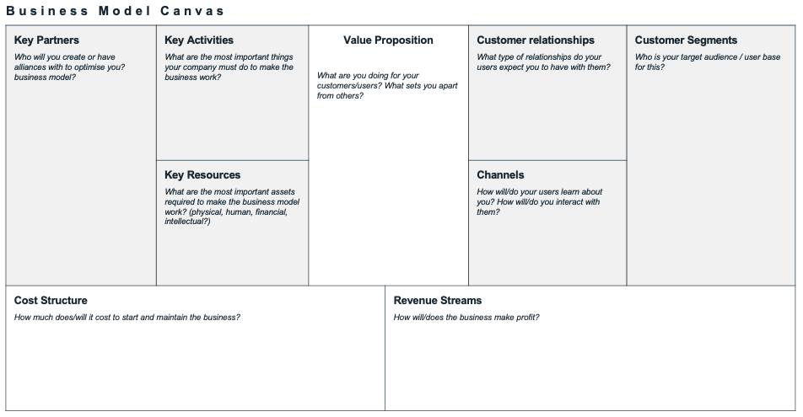
Business Model Canvas
A business model canvas is a template to help develop new or documenting existing business models. It helps to visualise the building blocks of a business.
For this project, we will use this template as a tool to organise the information that you were asked to define in the previous suggested template.
This canvas is very popular among people who are working in more entrepreneurial ventures in the private sector but also in government.
The business model canvas was designed by business theorist Alexander Osterwalder.
> template on next page

Slide 14
Business Model Canvas
Key Partners Who will you create or have alliances with to optimise you? business model? | Key Activities What are the most important things your company must do to make the business work? | Value Proposition What are you doing for your customers/users? What sets you apart from others? |  | Customer relationships What type of relationships do your users expect you to have with them? | Customer Segments Who is your target audience / user base for this?
 | Key Resources What are the most important assets required to make the business model work? (physical, human, financial, intellectual?) |  |  | Channels How will/do your users learn about you? How will/do you interact with them?
Cost Structure How much does/will it cost to start and maintain the business? |  |  | Revenue Streams How will/does the business make profit?

Slide 15
Getting to know the Startup Solutions

Slide 16
Agenda
Time: 3 Hours
5 mins | Introduction and objectives for the day
30 mins | Startup Solution presentation
30 mins | Activity part 1
15 mins | Break
30 mins 45 mins | Activity part 2 Debrief

Slide 17
Startup Solution Presentation (add slides or materials)

Slide 18
Suggested Activities
Please select one or several activities

Slide 19
Assumptions and Questions
ACTIVITY

Slide 20
Assumptions and Questions
1 - 1.5 hours
In person or online
To help the team understand what part of the Startup solution they know and what they still need to find out.
Reduce risk in the project by stating assumptions, identifying the riskiest ones and how might they be mitigated.
Public Sector teams to do this activity after listening to the Startup solution presentation.
Ensure to present the activity before the Startup solution presentation
Startups,
Public Sector Core Team but If other representatives from the Public Sector are present, they can likewise participate,
Additional Public Sector colleagues
Post-its
Paper

Slide 21
Assumptions and Questions
1
Identify assumptions and questions (20 minutes)
As individuals, write one assumption or question per post-it. Write as many as you can think of.
What do we mean by assumption in this context?
Since Public Sector actors might be new to the technology side, Startup jargon or specific details of the Startup solution, there might me some facts that only rely on suppositions they have as new actors in this field.
We will consider those as assumptions, meaning, statements that are believed to be truth by someone and that are key to the issue that needs to be solved.
If they do not have assumptions, they might have doubts about the problem. We will call these questions.
Notes:
Instructions for facilitator:

Slide 22
Assumptions and Questions
Examples of assumptions
“The data presented by the government seems not to consider people from 18-34 years old”
“That kind of user likes to use digital solutions”
“Men and women older than 60 prefer to reach the service using remote channels”
“The municipality has no capabilities nor capacity to deal with this problem”
“The solutions that are available in the market are much cheaper but very low quality”
Notes:
Instructions for facilitator:

Slide 23
Assumptions and Questions
2
Teams share assumptions and questions
5 mins per team: Facilitators ask the Public sector Team to share their assumptions and questions about the problem.
As people share, add each teams post-its onto the list of assumptions organised by assumption and questions. Group together similar ones.
Get people to think about:
What they heard in the presentation
What questions they still have
What assumptions they have about the problem
Assumptions
Questions
Notes:
Instructions for facilitator:

Slide 24
Assumptions and Questions
High risk
3
Map assumptions and questions to assess risk
15 mins
Draw a 2 x 2 grid like the one picture on the right. You can also prepare this in a digital format if preferred.
Teams will need to evaluate each post-it and plot them onto the grid where they think is makes the most sense
Risk: degree in which this question or assumption can have a high or low risk for the project if they are not clarified.
Certainty: degree in which the response to this question or assumption is known or not known by the team.
We recommend having a 15-20 min break after this activity
Certain
Un-certain
Low risk
Notes:
Instructions for facilitator:

Slide 25
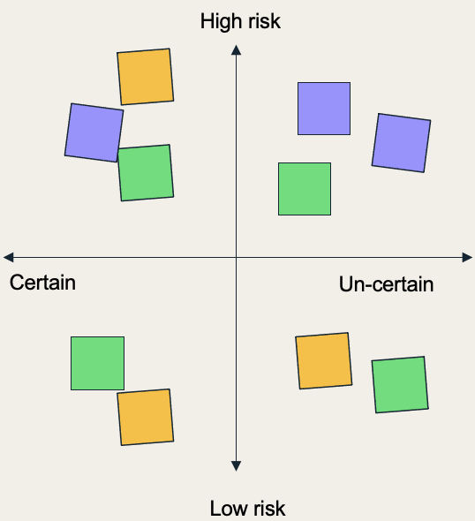
Assumptions and Questions
Assumptions and questions
How might we validate or invalidate it?
4
Take the high risk and uncertain items and stack into a list
15 mins
The quadrant is prioritised since it’s critical to better understand first what we don’t know much about, and since we don’t know, can have a higher impact on the project.
Each team should go through each item and think about different way to validate or invalidate each.
For example, do you need to talk to someone? Is someone in the room able to clarify this? Do you need to test something with staff or users? Do you need to do more research?
Notes:
Instructions for facilitator:

Slide 26
Assumptions and Questions
5
Teams share their list of riskiest assumptions and questions.
5 mins per team
6
What happens to the riskiest assumptions?
Keep these riskiest assumptions in a live document (e.g. GoogleDoc, WordDoc).
We could use them later for:
Follow up questions for the Public Sector organisation team.
Use them for planing the pilot (that will be introduced in Module 5).
Notes:
Instructions for facilitator:

Slide 27
Many Hats
ACTIVITY

Slide 28
Many Hats
20 minutes
In person or online
Getting participants to ask questions and probe about the problem so they can gain a deeper and better understanding about the problem at hand.
It gives people “hats” (roles) to look at a problem from different perspectives and prompts them to ask questions from those perspectives.
Public Sector teams to do this activity after listening to the Startup solution presentation.
Ensure to present the activity before the Startup solution presentation
Startups,
Public Sector Core Team (if other representatives from the Public Sector are present, they can likewise participate),
Additional Public Sector colleagues
“Hat roles” digitally ready to send to participants or printed to give out in person.
Post-its or a document to take notes and capture questions

Slide 29
Instructions
1
Customise and amend the ‘hat roles’ in the template
The template provides some suggestions on types of ‘hats’ to use. Amend and add the roles as necessary and that are relevant for the problem space.
4
After the presentation, get people to ask their questions and capture anything that needs to be an action
You should help capture things that need more research, followup or has an action. Collect post-its to collate as questions that still need to be answered.
This can then be shared with everyone, and can also be a list for the start-ups or the Public Sector organisation team to follow-up on.
2
Give out the different “hats” before the presentation by the Public Sector organisation, either:
Randomly assign individuals a hat
Or 1 hat per team - make there are enough hats with the number of teams.
3
During the presentation, get people to write questions on post-its
They should be thinking from the perspective of the “hat” they received.
They can still ask other questions if they have it.
Notes:
Instructions for facilitator:

Slide 30
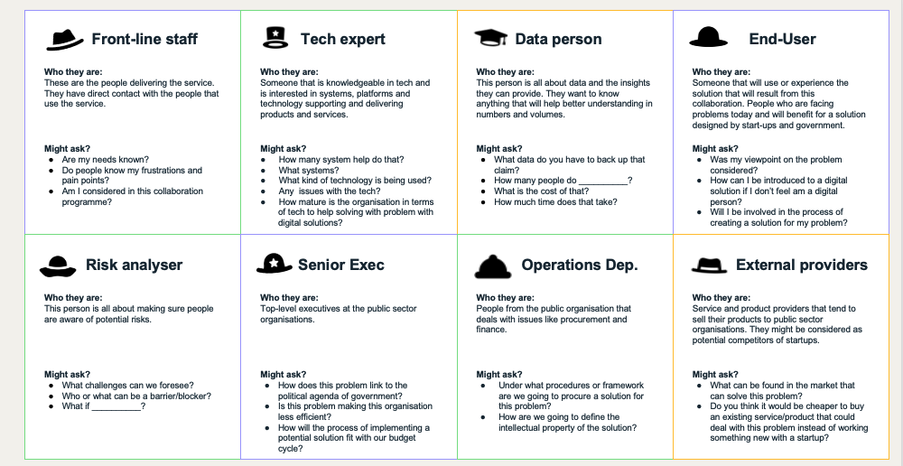
Hat Roles
Hat Roles template
The template provides some suggestions on types of ‘hats’ to use. Amend and add the roles as necessary and that are relevant for the problem space.
How to print
Print out on a A4 or A3 paper, single sided, and cut out into cards.
Use it on the computer
Show this on a screen or send to the participants. Assign or get people to pick a role.

Slide 31
Front-line staff
Tech expert
Data person
End-User
Who they are:
These are the people delivering the service. They have direct contact with the people that use the service.
Who they are:
Someone that is knowledgeable in tech and is interested in systems, platforms and technology supporting and delivering products and services.
Who they are:
This person is all about data and the insights they can provide. They want to know anything that will help better understanding in numbers and volumes.
Who they are:
Someone that will use or experience the solution that will result from this collaboration. People who are facing problems today and will benefit for a solution designed by start-ups and government.
Might ask?
Are my needs known?
Do people know my frustrations and pain points?
Am I considered in this collaboration programme?
Might ask?
How many system help do that?
What systems?
What kind of technology is being used?
Any issues with the tech?
How mature is the organisation in terms of tech to help solving with problem with digital solutions?
Might ask?
What data do you have to back up that claim?
How many people do __________?
What is the cost of that?
How much time does that take?
Might ask?
Was my viewpoint on the problem considered?
How can I be introduced to a digital solution if I don’t feel am a digital person?
Will I be involved in the process of creating a solution for my problem?
Risk analyser
Senior Exec
Operations Dep.
External providers
Who they are:
This person is all about making sure people are aware of potential risks.
Who they are:
Top-level executives at the Public Sector organisations.
Who they are:
People from the public organisation that deals with issues like procurement and finance.
Who they are:
Service and product providers that tend to sell their products to Public Sector organisations. They might be considered as potential competitors of Startups.
Might ask?
What challenges can we foresee?
Who or what can be a barrier/blocker?
What if __________?
Might ask?
How does this problem link to the political agenda of government?
Is this problem making this organisation less efficient?
How will the process of implementing a potential solution fit with our budget cycle?
Might ask?
Under what procedures or framework are we going to procure a solution for this problem?
How are we going to define the intellectual property of the solution?
Might ask?
What can be found in the market that can solve this problem?
Do you think it would be cheaper to buy an existing service/product that could deal with this problem instead of working something new with a Startup?

Slide 32
Empty hats
Use these empty templates if you can think of any other actor that might be relevant to include.
Give them a name or title, describe who they are and what they might ask.
?
?
?
Who they are:
Who they are:
Who they are:
Might ask?
Might ask?
Might ask?
?
?
?
?
Who they are:
Who they are:
Who they are:
Who they are:
Might ask?
Might ask?
Might ask?
Might ask?

Slide 33
De-Brief
ACTIVITY

Slide 34
Instructions
At the end of the session it is important to document the outcomes with regards to the Public Sector Challenge as common understanding for the joint Startup-Public Sector team.
This common understanding will support the team of having a joint goal for the collaboration phase.
The common understanding will be included in the Collaborative Innovation Canvas Key Tool in Module 4, Session 3.
Make sure to fill in the following slide based on an understanding that both sides share and can agree upon.
2
Next to the joint understanding of the Public Sector Challenge, there will certainly be points that are still unclear or uncertain.
These assumptions and uncertainties have to be documented likewise, as these will be included in the Assumption and Adaptation Backlog Key Tool in Session 3 of this module.
Fill in the assumptions and open questions based on your previous discussion on the slide. After the next Module, presenting the Startup solution, possible adaptation agreements will be included.
1
Notes:
Instructions for facilitator:

Slide 35
Common Understanding of the Public Sector Challenge
Based on the Public Sector Challenge presentation and the following discussion throughout the Activities “Riskiest Assumption“ and/or “Many Hats“ participants have gained a thorough understanding of the Public Sector Challenge
Please use the following template to formulate a joint understanding of the Public Sector Challenge, its scope and the target group that is affected by the challenge.
Please feel free to add additional information or sections to personalize your Common Understanding template.
Use the material presented by the Public Sector Organisation, as well as your discussions during the session as basis. If there is no agreement on certain aspects or specificities, include the points as assumptions in the second canvas.

Slide 36
Common Understanding of the Startup Solution
What is the Solution that you want to implement together to tackle the Public Sector Challenge?
What aspects of the broader Public Sector Challenge will not be solved by the solution ?
What target group will be addressed by the solution and how (end-user, intermediary, society, …)?
Other important aspects, that you would like to document, based on your discussion?

Slide 37
Adaptation and Assumption Backlog
Based on the Startup Solution presentation and the following discussion throughout the Activities “Riskiest Assumption“ and/or “Many Hats“ participants have gained a thorough understanding of the Startup Solution and how it contributes to solving the Public Sector Challenge.
Please record everything that is not yet clear or uncertain, in order to include it at the later stage in the Adapation and Assumption backlog.
Elements that might be unclear or based on assumptions could be in the following categories:
Knowledge of the user (end-user, intermediary, society, etc.)
Value proposition
Involvement of stakeholders (internal/external)
Deleminations of the problem

Slide 38
Common Understanding of the Startup Solution
Riskiest Assumptions
Open Questions
Steps in the Collaboration Process to address these
Steps in the Collaboration Process to address these

Slide 39
Solution Adaptation Backlog

Slide 40
Solution Adaptation Backlog
The Solution Adaptation Backlog is a tool that allows the joint Public Sector Startup team to record assumptions and adaptation needs to the Startup solution throught the course of the project.
In order to make sure that open questions and assumptions that are still not validated are recorded, the Assumption Backlog gives the team the space to record these, to include these into the piloting of the Startup solution.
At the same time, during the preceeding discussions it might have been already apparent, that certain features of the Startup solution need to be changed, in order to use it in a Public Sector context. The Solution Adaptation backlog provides the space to jointly (!) agree on possible adaptations.

Slide 41
Hypothesis / Assumption Backlog
Think about gaps you have identified.
Any weaknesses, threats and opportunities?
Do you know enough about your users? Who do you need to interview? To test with?
What do you need to still test?
What are your key assumptions? Assumptions about the problem / solution?
What do you think you need to do based on what you don’t know?
How might you test and validate your hypothesis or assumptions?
EG. more data on X, need to interview, need to learn more about...
What actions will you need to take or plan for?
EG. Will need to conduct a round of interviews, need to get help to access data...
If you can, identify who can help or take ownership of some of the actions.

Slide 42
Adaption Backlog

