Slide 1
Fitting the Startup Solution to the Public Sector Context

Slide 2
Objectives
The objective of this session is to record the outcomes of the previous two sessions, deep-diving into the Public Sector Challenge and the Startup Solution and to transfer these outcomes into actionable items. In this way, the first steps to align the Startup solutions with the Public Sector context in which they will operate are taken.
Desired Outcome
Agreements, based on Session 1 and 2, are made and recorded in the two Key Tools, the Solution Adaptation Backlog and the Collaborative Innovation Canvas.
Notes:
Maps are what we use to find our way.

Slide 3
Content
Preparing and planning the session
Activity: SWOT analysis
Activity: Collaboration Goal and Advantage
Activity: Stakeholder Mapping
Key Tool: Collaborative Innovation Canvas
Key Tool: Solution Adaptation Backlog
To jump right to the respective slides you’ll have to be in presentation mode!

Slide 4
Preparing and planning the session
1
Review this deck and activities
Make any changes as needed with the agenda and the activities.
4
Prepare the room and any materials needed based on your selected activities
You will want to get a space that has room everyone to walk around. You will need a table or wall space for each startup team.
If the session is hosted online, make sure you have the meeting setup in time on a platform that everyone can access. If you are planning to have breakout rooms, make sure that the platform you choose offers this option.
2
Send out the summary templates so that people can prepare before the session and are ready to bring in these summary sheets.
Problem and context summary for the Public Sector Organisation
Startup solution summary for each of the Startups
3
Remind everyone they will need to bring their previous presentation and materials they presented in the previous 2 sessions.
Notes:
Instructions for facilitator:

Slide 5
Fitting the Startup Solution to the Public Sector Context

Slide 6
AGENDA
TIME: 3 - 4 hours
5 mins | Introduction and objectives for the day
60 mins | Activity: SWOT analysis
5 mins | Break
30 mins | Collaboration Goal and Advantage
5 mins | Break
45 mins 60 mins | Stakeholder Mapping Key Tool: Collaborative Innovation Canvas
5 mins | Debrief and what’s next

Slide 7
The Problem and each Teams potential Solution
By now you should have a better understanding about the problem that needs to be solved and the potential solutions/products that each startup has to offer.
These two things are not necessarily aligned yet - there is still some work to be done.
Let’s start to work on what needs to be done.
Public Sector Challenge
Startup Solution
Risks and unknowns can exist anywhere

Slide 8
Let’s get started!

Slide 9
SWOT Analysis
ACTIVITY

Slide 10
SWOT Analysis
50 mins
In person or online
To help teams identify challenges and weaknesses to address or improve as well as things to pull from, like opportunities and strengths of the joint Collaborative Innovation project.
Early on in the project - when there is sufficient understanding of the problem that needs to be solved and the proposed solution to it.
Public Sector – Startup Core Team
Remote/online:
Shared SWOT template in a shared document
In person:
Post-its and pens/markers
SWOT analysis template
Problem and solution information / summary templates filled in

Slide 11
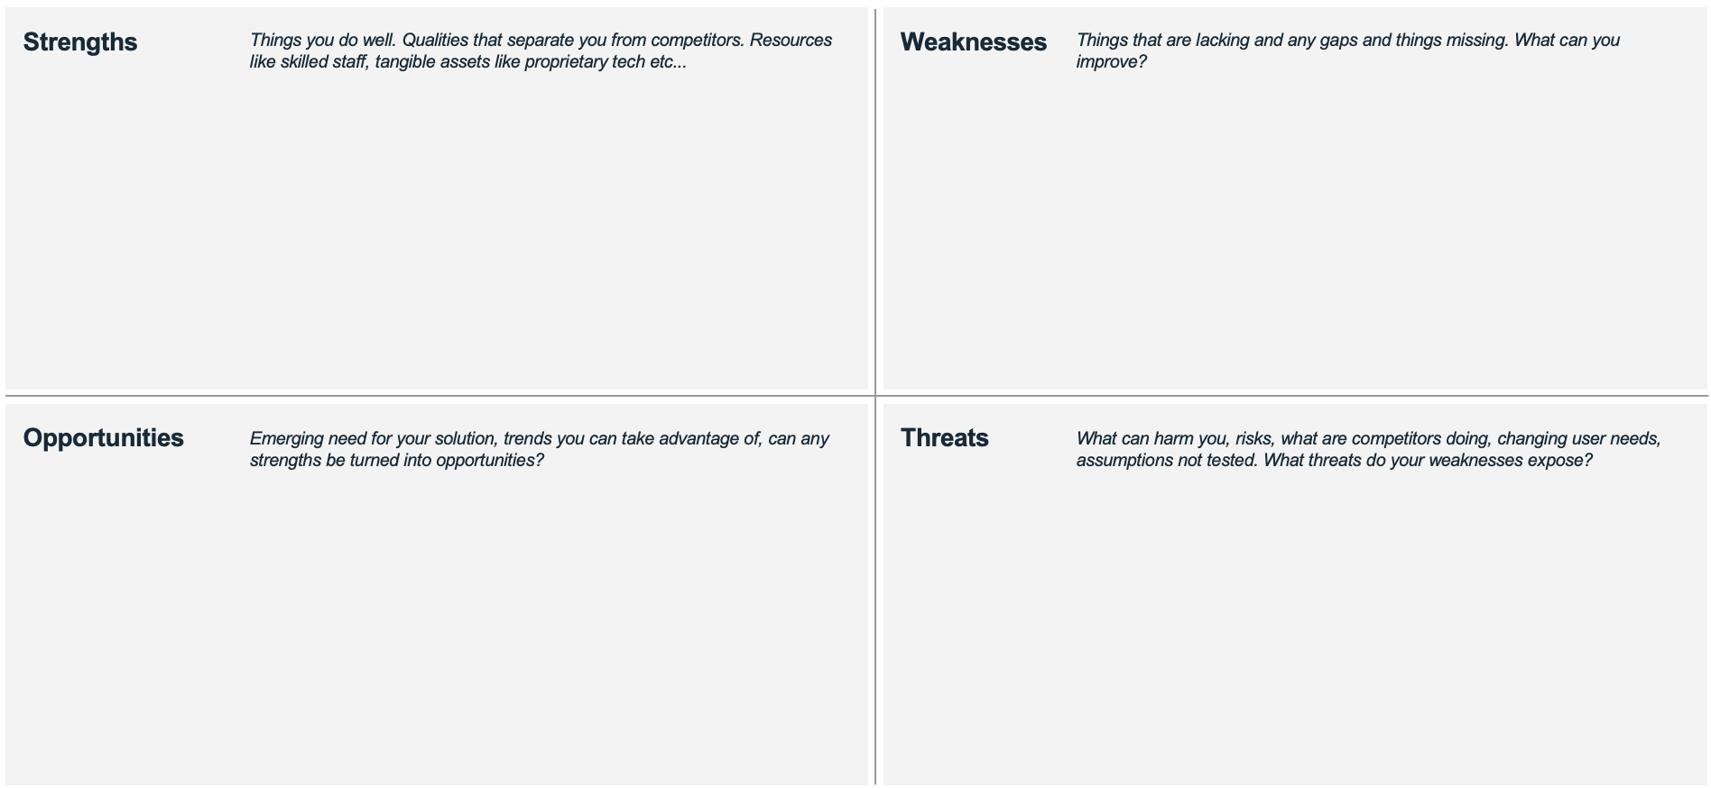
SWOT Analysis
Total time: 50-60 mins
1
Get into groups
Each startup will need to sit at their own table/breakout room with 1-2 people from the public sector organisation.
For reference:
Public sector: bring a copy of your summary sheets and past session materials.
Startups: have your summary sheets ready and previous session materials to refer to.
Each team should also have a SWOT analysis template.
3
Repeat step 2 with the rest of the quadrants until it’s all completed
2
Identify things for the first quadrant: Strengths.
5-10 mins - Do this individually
You can review and think about what you learned about the problem and what you know about the potential solutions to identify questions you have, gaps etc.
5 mins - Everyone shares what they have jotted down for that quadrant and group or combine similar thoughts..
Notes:
Instructions for facilitator:

Slide 12
SWOT Analysis
How to use these templates
You can print, use digitally or even draw up the SWOT matrix on paper or on whiteboard.
This is used to help teams do a SWOT analysis.
How to print
A3 or A2 size.
Use it on the computer
Copy the template page into a new document to share with participants to fill out.

Slide 13
SWOT Analysis
Strengths
Weaknesses
Things you do well. Qualities that separate you from competitors. Resources like skilled staff, tangible assets like proprietary tech etc...
Things that are lacking and any gaps and things missing. What can you improve?
Opportunities
Threats
Emerging need for your solution, trends you can take advantage of, can any strengths be turned into opportunities?
What can harm you, risks, what are competitors doing, changing user needs, assumptions not tested. What threats do your weaknesses expose?

Slide 14
SWOT Analysis
1
Strengths and Opportunities
The strengths and opportunities identified in the activity will serve as basis for the formulation of the Collaboration Goal and the Collaborative Advantage (next activity).
2
Weaknesses and Threats
The weaknesses and threats identified in the activity will serve as a supplement to the open assumptions and questions from the previous two sessions to be filled in the Solution Adaptation Backlog.
Notes:
Instructions for facilitator:

Slide 15
BREAK!
Get up, walk around, stretch a little and open the windows if possible!

Slide 16
Collaboration Goal and Advantage
ACTIVITY

Slide 17
Collaboration Goal & Advantage
30 mins
In person or online
To help teams identify challenges and weaknesses to address or improve as well as things to pull from, like opportunities and strengths.
After a thorough presentation and discussion of the Public Sector Challenge and the Startup Solution.
Public Sector –Startup Core Team
Public Sector Challenge Summary Sheet
Startup Solution Summary Sheet

Slide 18
Collaboration Goal & Collaborative Advantage
Based on the common understanding on the Public Sector Challenge (Session 1), the Startup solution (Session 2) and the preceeding SWOT analysis, the joint Public Sector –Startup Team can forumlate a joint Goal statement and reflect on the advantage of the joint collaboration.
The jointly formulated statements will be included in the Key Tool Collaborative Innovation Canvas at the end of the session.
The goal of this activity is to bring forward the advantages of the cooperation to build on these in the collaboration process and to communicate them to third parties (e.g. within the Public Sector, or to third parties, such as citizens)

Slide 19
Common Understanding of the Startup Solution
What is the Solution that you want to implement together to tackle the Public Sector Challenge?
What aspects of the broader Public Sector Challenge will not be solved by the solution ?
What target group will be addressed by the solution and how (end-user, intermediary, society, …)?
Other important aspects, that you would like to document, based on your discussion?

Slide 20
Common Understanding of the Public Sector Challenge
What’s the Challenge that you are trying to solve together? What is the scope and deliminations?
What aspects of the broader context will not be part of the Public Sector Challenge you want to solve together?
What target group is affected by the challenge (end-user, intermediary, society, …)
Other important aspects, that you would like to document, based on your discussion?

Slide 21
Collaboration Goal & Collaborative Advantage
1
Individual Reflection
Take one Collaboration Goal & Collaborative Advantage sheet per person and work on a short formulation (3-6 sentences per category) individually for 15 minutes.
Base your input on the understanding and take-aways that you have from the previous sessions and include aspects that are relevant for you and motivate your personally in the joint project.
2
Group Discussion
Based on the individual reflections, group together either in small groups (mix Startups and Public Sector) or in a big group, depending on the size, to map and sumarize the individual relfections into one joint formulation per category.
Notes:
Instructions for facilitator:

Slide 22
Collaboration Goal & Collaborative Advantage
Collaboration Goal
Collaborative Advantage
From your perspective, based on the Public Challenge Presentation and the Startup solution presentation, what is the goal you should set yourself for your joint Collaborative Innovation Project? How can this goal formulation build on the strengths and opportunities of your team and the project?
From your perspective, based on the Public Challenge Presentation and the Startup solution and the SWOT analysis, what are the key aspects, that give your joint collaboration an advantage? What can you do better together? How can you complement each other?

Slide 23
Stakeholder Mapping
Activity

Slide 24
Stakeholder Mapping
Next to a thorough understanding of the Collaboration Phase, the necessary steps to prepare the Collaboration Phase and the needed instruments to identify possible Startup solutions, it is important to identify an mobilize key stakeholders in your organisation.
The Activity Stakeholder Mapping provides you with a tool to identify, map and cluster the most relevant stakeholders in your organization that you need to mobilize to different degrees.
In the Preparation Phase, the Public Sector partner has already concluded the stakeholder mapping activity, whose results have been recorded in the the Key Tool Stakeholder Engagement Plan (Module 2: Session 1: Preparation of the Collaboration Phase)
If this Key Tool is available, this can be a solid basis for extending and re-evaluation the Stakeholder Mapping and Engagement Plan with the new insights and perspective by the joint Public Sector – Startup team.

Slide 25
Stakeholder Mapping
45 mins
In person or online
Identifying the relevant units and persons within and outside your organisation that you need to have on board to realize your collaborative innovation project
After having a through understanding of the Public Sector Challenge and the Startup solution, in order to (review or) identify the relevant stakeholder to be involved in the Collaboration project.
Facilitators
Startup – Public Sector Core Team
Stakeholder Mapping Template
note-taking material
Pens/markers

Slide 26
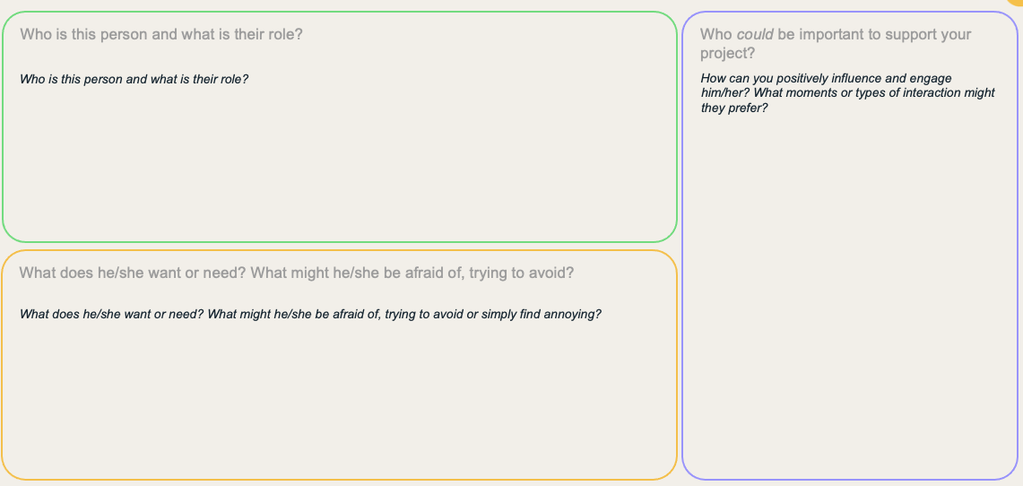
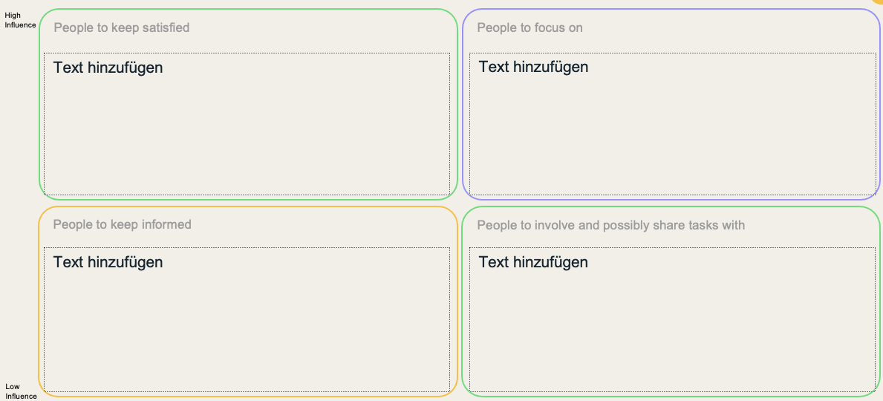
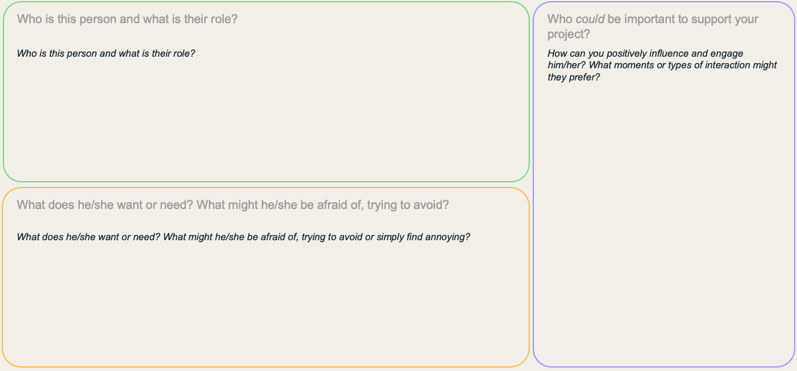
Template for Stakeholder Mapping
How to use these templates
Use these templates within the facilitator team to help you reflect on the interviews conducted. This step is crucial in identifying the stakeholders you need to mobilize.
How to print
If you are printing A3 size would be ideal as the minimum size.
Use it on the computer
Copy the template page into a new document to share with participants to fill out. Alternatively copy only the questions and discuss them

Slide 27
1/3 Who do you need to support your project?
Who are the critical influencers, partners and stakeholders that can help your project succeed or make it fall?
What are additional resources that could increase the impact of your project?
Who are the critical influencers, partners and stakeholders that can help your project succeed or make it fall?

Slide 28
2/3 Who do you need to engage more closely?
High Influence
Low Influence

Slide 29
3/3 How can you engage and manage your main stakeholders?
Who is this person and what is their role?
How can you positively influence and engage him/her? What moments or types of interaction might they prefer?
What does he/she want or need? What might he/she be afraid of, trying to avoid or simply find annoying?

Slide 30
Collaborative Innovation Canvas

Slide 31
Key Tools
What are Key Tools?
Key Tools are key documents that will retain importance throughout the Collaborative Innovation Process. Here key information that has been gathered throughout the Sessions will be recorded, so that this information can be used in later sessions or in communicating with external stakeholders on the process.

Slide 32
Collaborative Innovation Canvas
The Collaborative Innovation Canvas summarizes the Collaborative Innovation project and its main features, proposed activities and objectives in one single overview.
The Collaborative Innovation Canvas can be used to communicate and present the project to third parties and provides a reference framework for the duration of the collaboration.
The Collaborative Innovation Canvas is based on the discussions of the Public Sector Challenge (Session 1) and the Startup Solution (Session 2).

Slide 33
Collaborative Innovation Canvas
How to use this template
Start by recording the insights of this session in the three left columns. The information needed in the three right-hand columns will be added after Session 3.
How to print
If you are printing A3 size would be ideal as the minimum size.
Use it on the computer
Copy the template page into a new document to share with participants to fill out. Alternatively copy only the questions and discuss them

Slide 34
Collaborative Innovation Canvas

Slide 35
Solution Adaptation Backlog

Slide 36
Solution Adaptation Backlog
The Solution Adaptation Backlog is a tool that allows the joint Public Sector Startup team to record assumptions and adaptation needs to the Startup solution throught the course of the project.
In order to make sure that open questions and assumptions that are still not validated are recorded, the Assumption Backlog gives the team the space to record these, to include these into the piloting of the Startup solution.
At the same time, during the preceeding discussions it might have been already apparent, that certain features of the Startup solution need to be changed, in order to use it in a Public Sector context. The Solution Adaptation backlog provides the space to jointly (!) agree on possible adaptations.

Slide 37
Hypothesis / Assumption Backlog
Think about gaps you have identified.
Any weaknesses, threats and opportunities?
Do you know enough about your users? Who do you need to interview? To test with?
What do you need to still test?
What are your key assumptions? Assumptions about the problem / solution?
What do you think you need to do based on what you don’t know?
How might you test and validate your hypothesis or assumptions?
EG. more data on X, need to interview, need to learn more about...
What actions will you need to take or plan for?
EG. Will need to conduct a round of interviews, need to get help to access data...
If you can, identify who can help or take ownership of some of the actions.

Slide 38
Adaption Backlog

